Slide 1

UNIVERSITY COLLEGE OF ENGINEERING(BIT CAMPUS)
ANNA UNIVERSITY ,TIRUCHIRAPALLI- 620 024.
DEPARTMENT OF INFORMATION TECHNOLOGY
IT6811-PROJECT WORK
Exploiting Computational Complexity of Runtime Measurements in the Cloud Rollback
Under Guidance of Submitted By,
Mrs.S.Jayanthi, R.Arularasan (810015205009)
Department of CSE/IT, A.Arunkumar (810015205010)
BIT Campus,
Trichy.

Slide 2
Title
Exploiting Computational Complexity of Runtime Measurements in the Cloud Rollback

Slide 3
Abstract
The rollback is a collection of changes, is widely recognized as valuable support for dependability.
To improve the dependability of cloud-based systems, use an AI planner to automate discovering an appropriate sequence of available operations from an API, in order to rollback to a checkpoint.
The system executes the corresponding compensating actions in the reverse order.

Slide 4
Existing System
However, deletion operations are not generally reversible, because creation would not revive the deleted resource in its state at the time of deletion.
It does not scale well when the number of operations increases further.

Slide 5
Drawbacks
For instance, inadvertently deleting a virtual disk results in the complete loss of the contained data.
Execution times or cost of operations would be increasing.
repeats the edge addition process.

Slide 6
Proposed System
The undo system offers a wrapper for cloud APIs checkpoint, when the user asks to delete a resource, the wrapper sets a delete flag, indicating that the resource is logically deleted.
One approach to facilitate scalable rollback on an API controlled cloud platform is to use intermediate checkpoints.
AI planner to discover appropriate sequences of recovery actions for each planning task, and aggregate them into a complete rollback plan.

Slide 7
Advantages
To measure solution quality over time
The cluster communication between master and workers is minimal.
Checkpoint creation time can improve usability of the system.
ICR approach finds plans more quickly

Slide 8
Modules
System Administration
AI Planning
Checkpoints
Manual Checkpoint
Intermediate Checkpoint
Scalable Rollback
Performance Measurement

Slide 9
System Architecture
Cloud Service Provider
Third Party Auditor
AI Planning for Data Deletion
Client
Registration
Check Point
Roll back for recovery of Data
Data Storage Analysis

Slide 10
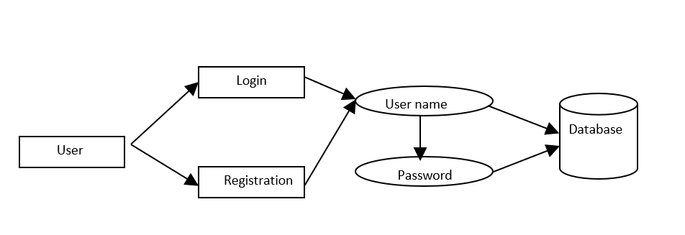
Data Flow Diagram Level-0

Slide 11
Data Flow Diagram Level-1
User Login
Store data
File Upload
Database

Slide 12
Data Flow Diagram Level-2
User Login
Check Point
AI planning for Rollback Data
Database

Slide 13
Literature Survey
S.No | Title | Technique Used | Advantage | Disadvantage
1 | Supporting undoability in systems operations-Ingo Weber, Hiroshi Wada, Alan Fekete, Anna Liu, and Len Bass(2013) | Undoability Checking Algorithm | To discover plans that achieve this, it perform a step of preprocessing before the actual planning: | If an unrecoverable error occurs, one cannot reverse back to the previous state of that resource.
2 | Scalable Rollback for Cloud Operations using AI Planning- Suhrid Satyal, Ingo Weber, Len Bass, Min Fu(2015) | Parallelize rollback plan generation | This system creates a number of AI planning tasks based on the intermediate checkpoints, uses an AI planner to discover appropriate sequences of recovery actions for each planning task. | The problem in such cases is that the underlying automated planning method from artificial intelligence (AI) faces a computationally hard problem.

Slide 14
S.No | Title | Technique Used | Advantage | Disadvantage
3 | A Study on Fault Tolerance Mechanisms in Cloud Computing-Mohammad H. Alshayeji, Mohammad Al-Rousan , Eman Yossef, Hanem Ellethy(2017) | Fault Tolerance in Cloud Computing techniques | It provides many advantages including service scalability and flexibility. | The storage capacity is an obstacle in order to improve system availability.
4 | Cloud application deployment with transient failure recovery -Ioannis Giannakopoulos , Ioannis Konstantinou, Dimitrios Tsoumakos and Nectarios Koziris(2018) | Error Recovery Algorithm | It provides lightweight file system snapshot mechanism, that aims at persisting the file system state prior to each script execution and, in case of failure, | in the general case, if a script is executed multiple times it will not always have the same effect.

Slide 15
Algorithms
Data Encryption Standard
Depth First edge exploration
Breadth First edge exploration
Divide and Conquer edge exploration
Subgraph optimization edge exploration
Random edge exploration

Slide 17
References
[1] D. Oppenheimer, A. Ganapathi, and D. A. Patterson, “Why do internet services fail, and what can be done about it?” in USITS’03: USENIX Symposium on Internet Technologies and Systems, 2003.
[2] J. Gray, “Why do computers stop and what can be done about it?” in Symposium on Reliability in Distributed Software and Database Systems, 1986, pp. 3–12.
[3] “AWS Elastic Compute Cloud (EC2),” http://aws.amazon.com/ ec2/, accessed: 2015-06-02.
[4] I. Weber, H. Wada, A. Fekete, A. Liu, and L. Bass, “Automatic undo for cloud management via AI planning,” in Proc. USENIX Workshop on Hot Topics in System Dependability, 2012.

Slide 18
THANK YOU.

